Slide 1

Bachus Database Design
By The Space Unicorns
2/24/25

Slide 2

Meet The Team
Jason Luttrell
Anthony Nguyen
Andrew Estrada

Slide 3
Problem Description
Bachus Winery is looking to modernize legacy operations with a new approach to data management. The goal is to provide a database that enables future expansion into automated and online inventory tracking, ordering, and reporting.
The Minimum Viable Product provides a data structure that supports the long-term online functionality goals while delivering the automated reporting immediately.
Reporting should provide the health of the business, inventory, and workforce.

Slide 4

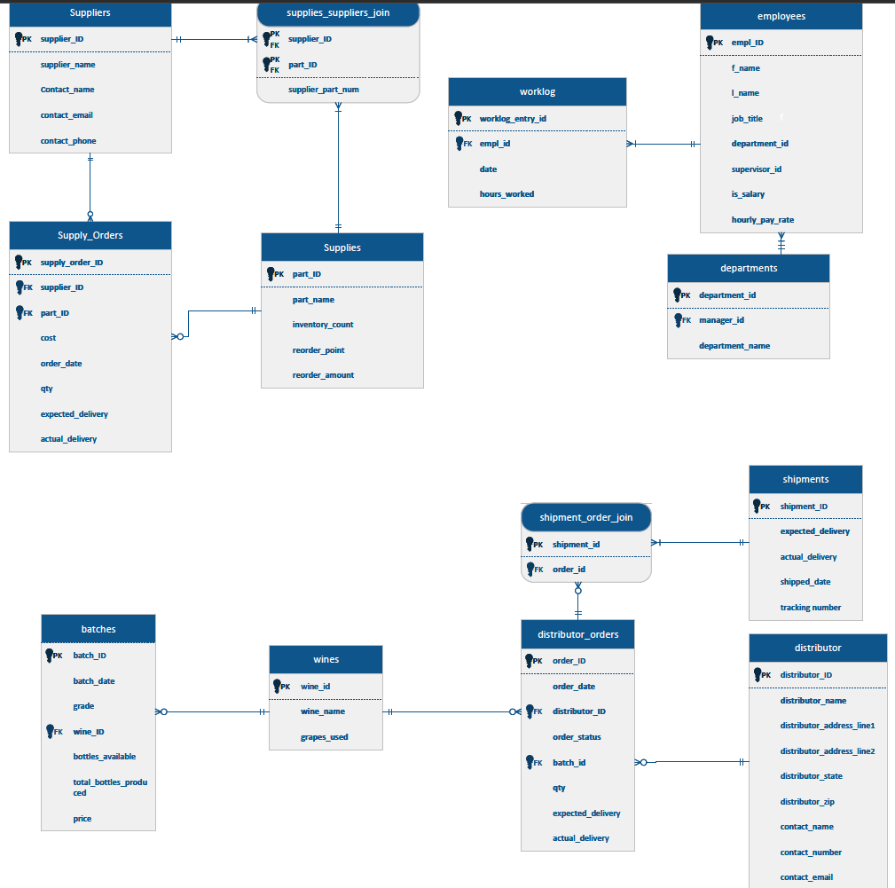
ERD The following three slides will present enlarged partial views of the ERD
C

Slide 5
ERD part 1

Slide 6
ERD part 2

Slide 7
ERD part 3

Slide 8
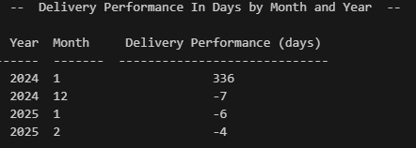
Report 1 of 3
The Delivery Performance In Day By Month and Year
Shows an average of the days late of all deliveries for a particular month
Positive numbers indicate the average is late
Negative numbers indicate the average is early
Sorted from earliest to latest month

Slide 9
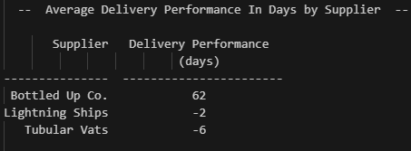
Report 2 of 3
Average Delivery Performance In Days by Supplier
Same information as the monthly report but by supplier
Allows the user to identify problem suppliers
Sorted by average days in descending order

Slide 10
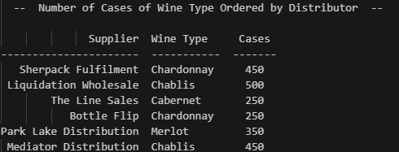
Report 3 of 3
Number of Cases of Wine Type Ordered by Distributor
Lists each distributor and the number of cases of each wine type that they order
If a distributor orders multiple types, there will be multiple rows for that distributor

Slide 11

Assumptions
Owners would be in an executive department and one owner would be the nominal manager of that department
Reorder quantities would be identified for each reorder part
Salaried employee compensation rates would be calculated hourly based on a 40 hour work week and 52 weeks a year
Salaried employees would be automatically logged as working a 40 hour week for payroll purposes.
One grape goes to one wine
All batches would be graded and priced individually
Orders would contain only 1 type of wine each.
Smallest order quantity is 1 case

Slide 12
Contact us
C
Starfieldoffice@spaceunicorns.com

